Slide 1
GEO-LDN
GEO-LDN’s federated capacity development approach
Amos T. Kabo-Bah
amos.kabobah@uenr.edu.gh
Notes:
(Notebook S. 38)
Refer to SPI report on ILUP proposals (ICCD/COP(15)/CST/2):
CD for Min of Plannung (GEO LDn MOOCs)
Use of tools: trends.earth, LUP4LDN, federated system → linkning the tools mentioned in the SPI reprt figure
Collaboration: S4ILUP, dialogue fora
Generation and sharing of expertise
Switzerland: How will the recommendations of the naitonal reort be implemented at national and local level. → GEO-LDN tries to contribute to the implemnetation of the proposals
Japan (Notebook S. 41) „two-way knowledge sharing → would arfue that there is even 3-way knowledge sharing needed: environmental community, LUP, science/data

Slide 2
GEO-LDN‘s federated and open approach in data analytics and standards and in capacity development
Federated approach in
data analytics and standards:
Reuse and improve existing data, tools and algorithms
Make tools „talk to another“ by developing and following standards and by connecting them via APIs
Connected tools address specific use cases, e.g. for integrated land use planning or for specific geographies
Federated approach in
capacity development:
Modules of post-graduate programme and MOOCs can be reused by others
Some post-grad modules will be available virtually for further training of professionals (MOOCs) and vice versa
Existing modules from partners to be used in post-graduate programme and in virtual trainings

Slide 3
GEO-LDN’s coherent and inter-linked approach
Stakeholder network: linking land use planning, environment, data, and science communities
Stakeholders as sounding board for developers of federated system
Stakeholders to identify capacity development needs
Capacity development offered to stakeholders
LDN Toolbox is content of capacity development
Federated System
Creating a toolbox of datasets and tools, based on minimum standards for interoperability
Capacity Development
Enable stakeholders to use data for achieving LDN
GEO-LDN
Secretariat
Stakeholder Engagement
Network of land use planners, geodata, environment, and science communites
3

Slide 4
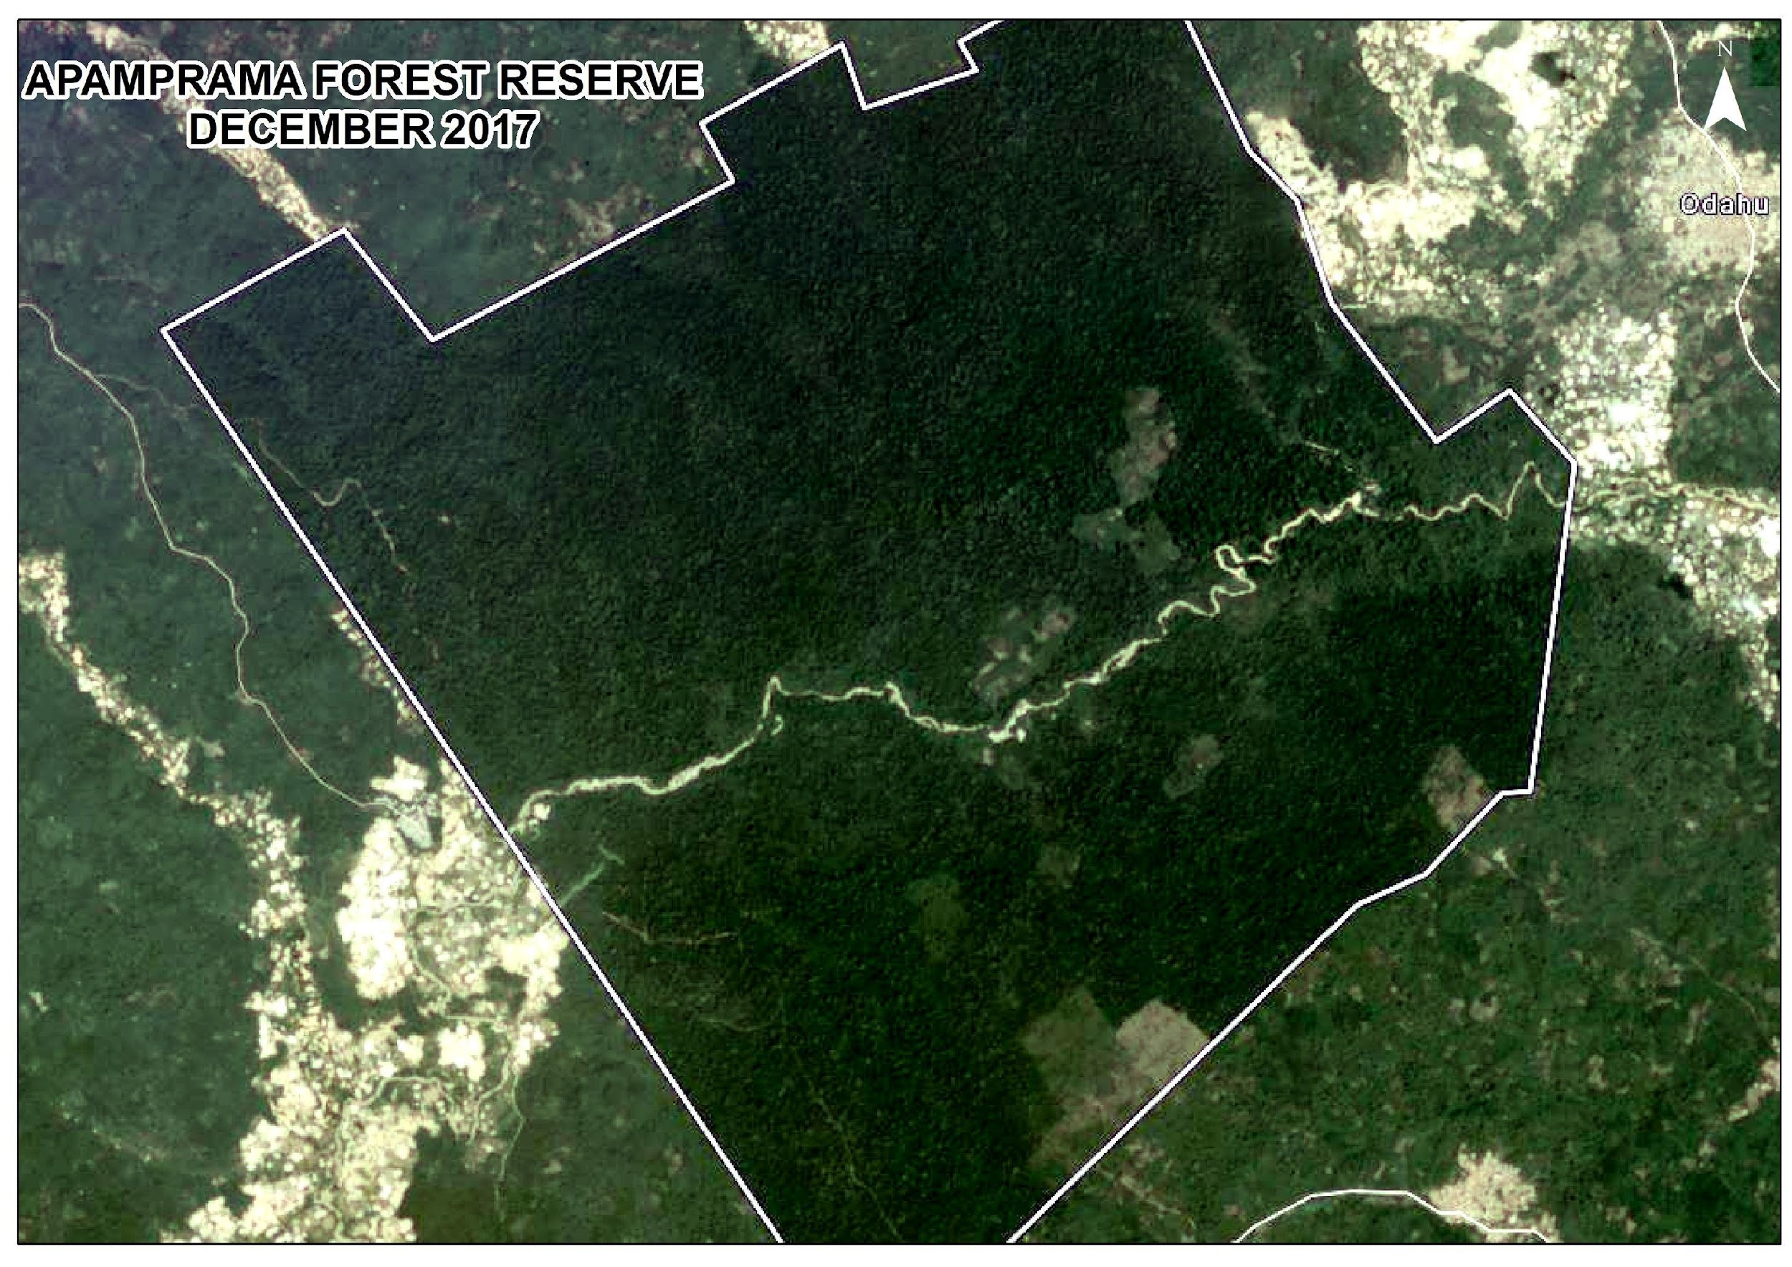
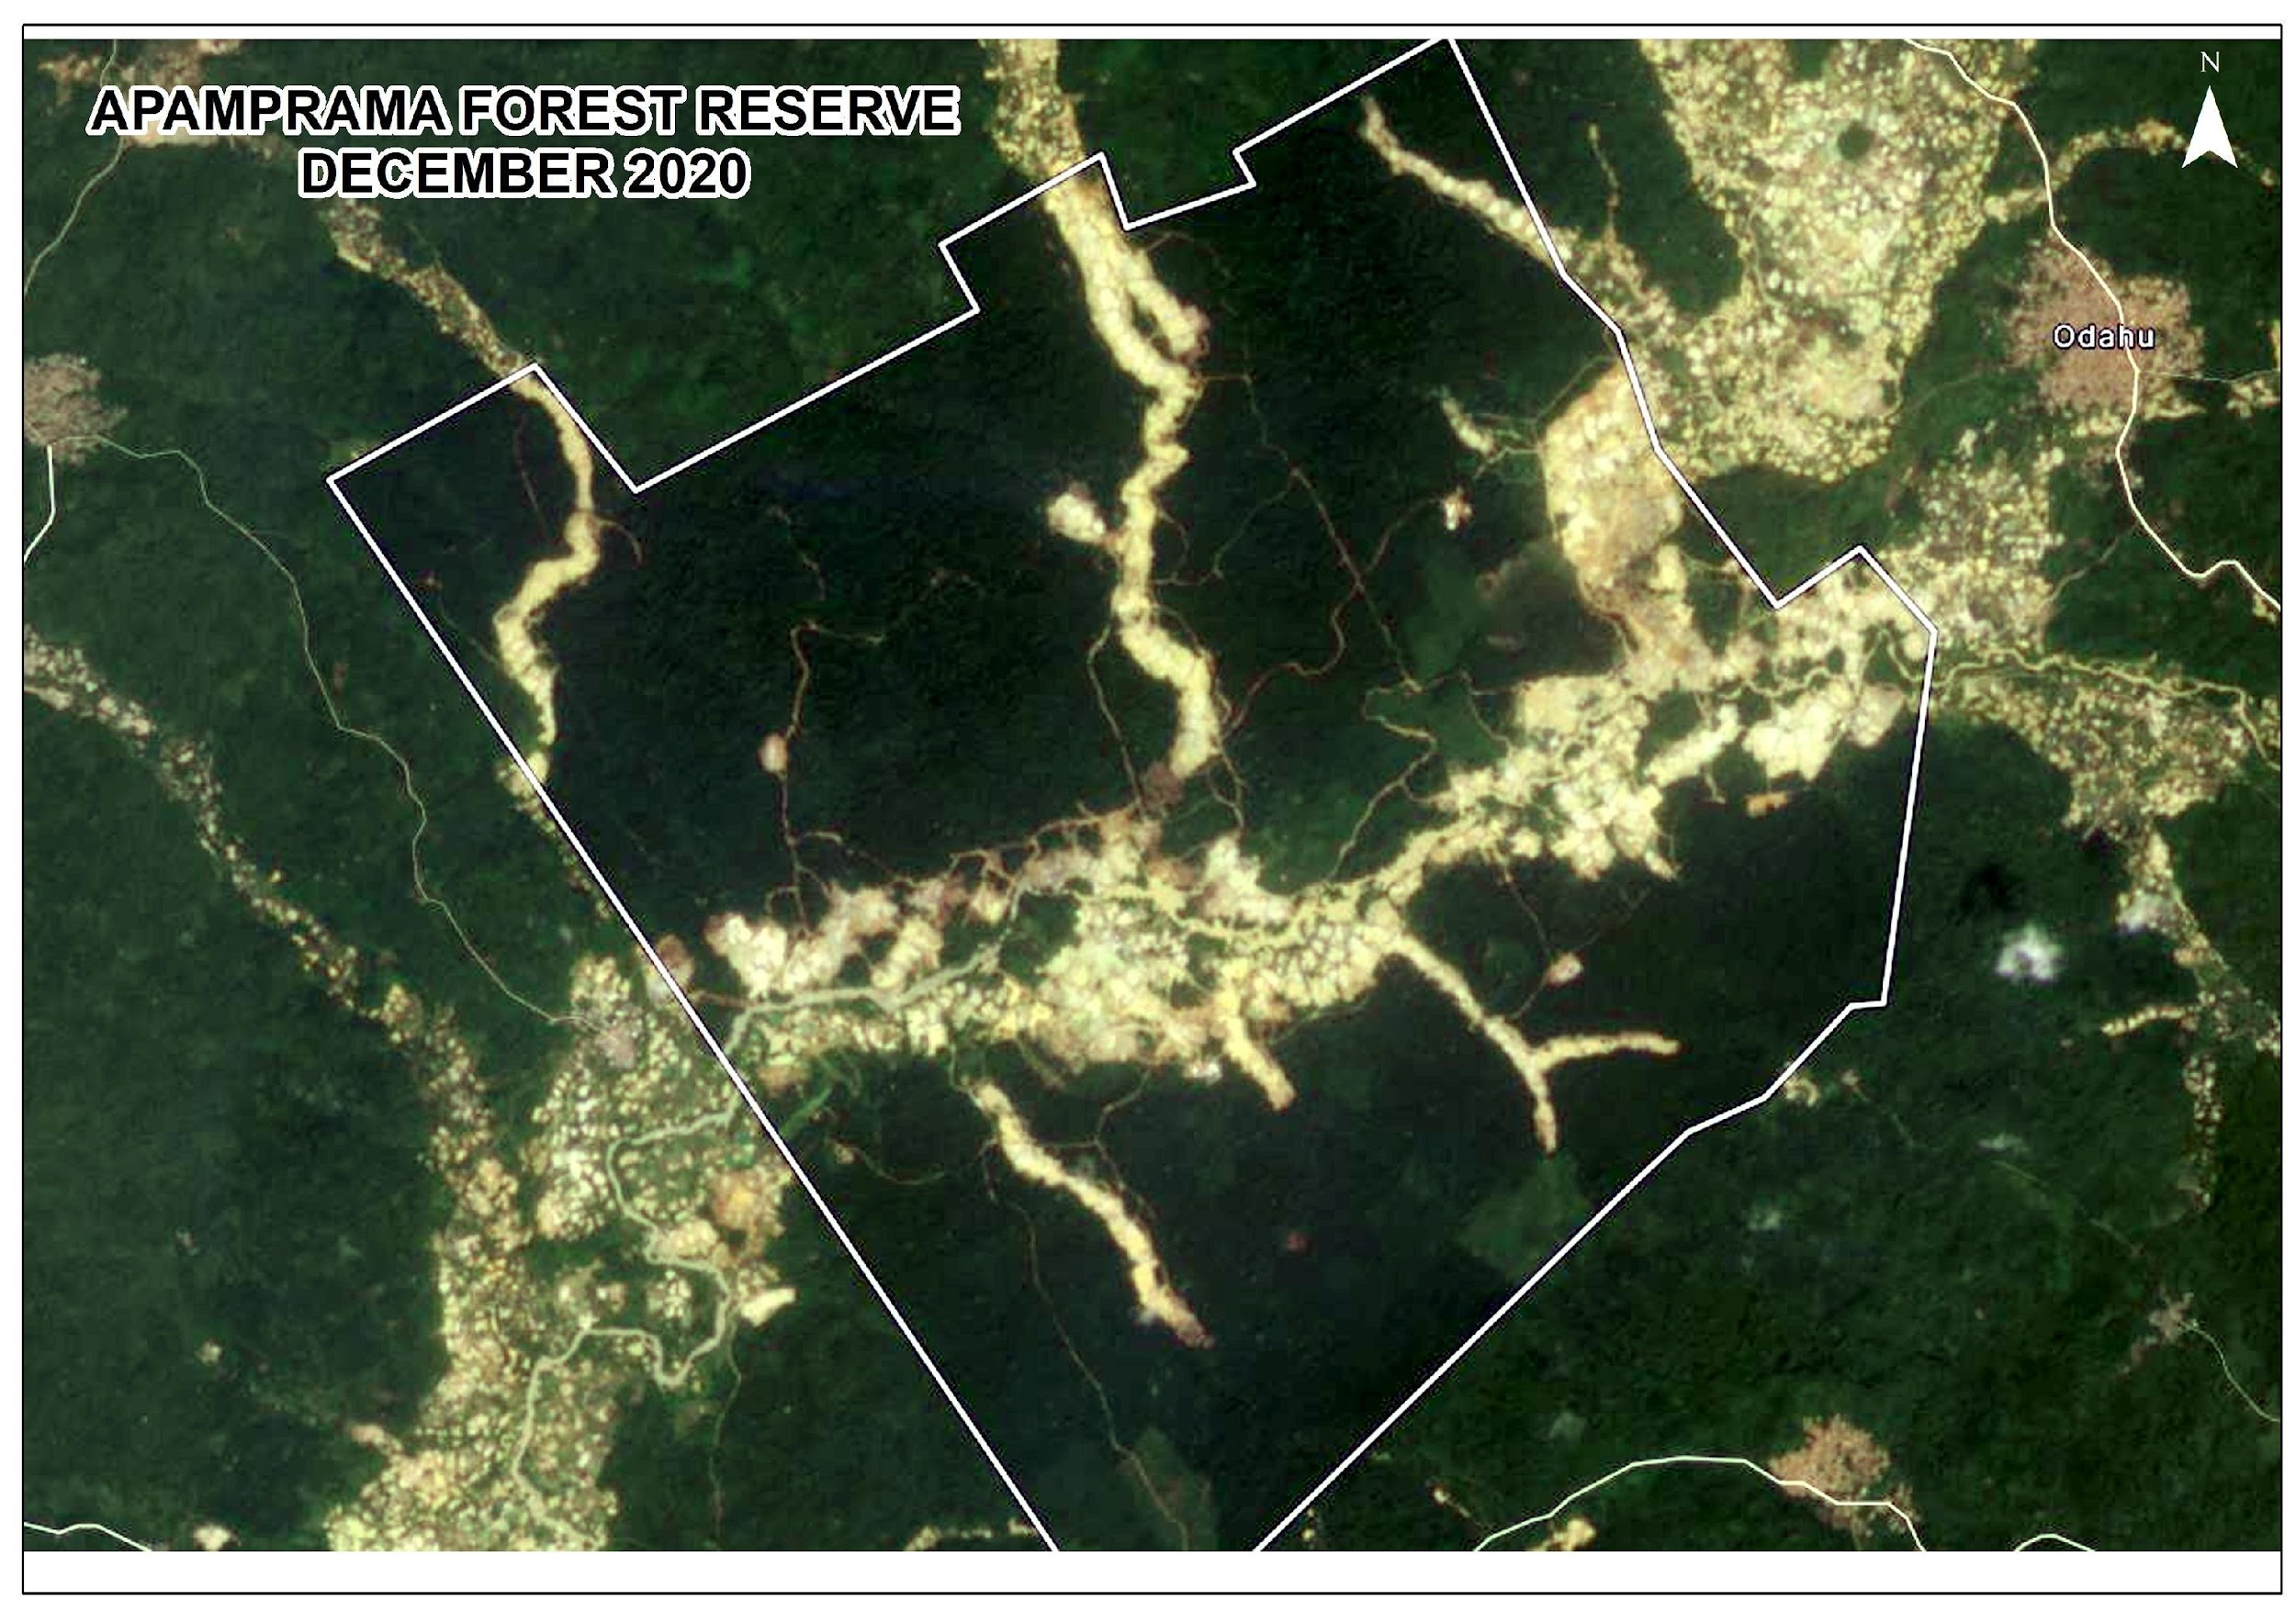
Rapid land use changes? Need for action…

Slide 5
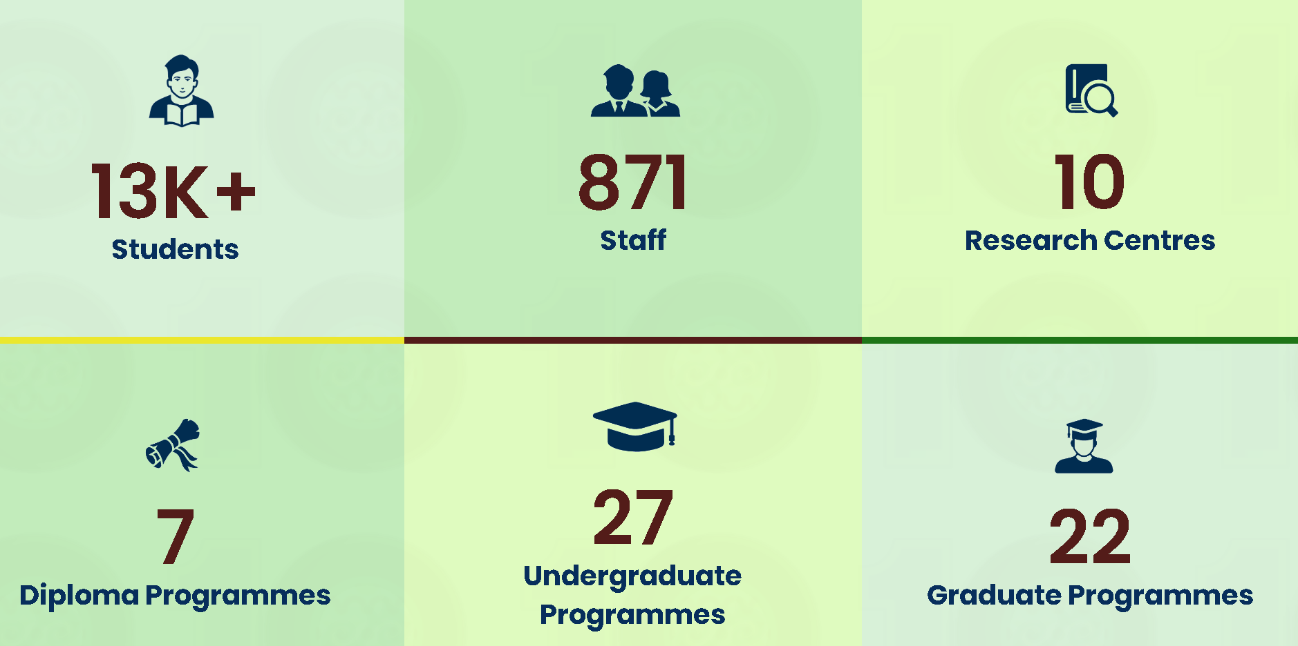
University of Energy and Natural Resources
The University of Energy and Natural Resources was established by an Act of Parliament ( Act 830) in 2011
The University has the mandate to provide higher Education, disseminate Knowledge and undertake Research related to Energy and Natural Resources

Slide 6
REGIONAL CENTRE FOR ENERGY AND ENVIRONMENTAL SUSTAINABILITY (RCEES)
The Regional Centre for Energy and Environmental Sustainability (RCEES) is an African Centre of Excellence set up in 2019 as part of the African Centers for Development Impact (ACE Impact) project by the World Bank.
In line with the overarching vision of the university of energy and natural resources, we are committed to providing quality teaching, learning, and research to advance the development of future leaders in the disciplines of Energy and Environment.
The Centre provides accredited tailor-made postgraduate programmes in the fields of Energy and Environment to develop and train expertise geared towards universal energy access, energy efficiency, and the promotion of renewable energy.

Slide 7
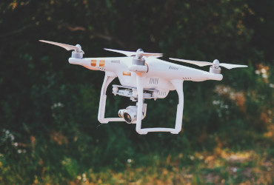
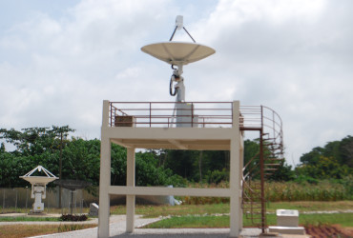
EARTH OBSERVATION, RESEARCH AND INNOVATION CENTRE (EORIC)
The vision of EORIC is to become a leading African Research Centre in the promotion and dissemination of value-added satellite and in-situ based data and information, transfer of ultra-modern affordable space science skills and technologies for meeting the needs of society.
The mission of EORIC is to promote, facilitate and support the acquisition and application of geospatial education, in areas of water, disasters, energy, climate, agriculture, ecosystems, weather, health and biodiversity.

Slide 8
Elements of the federated GEO-LDN Capacity Development approach
E-learning course
International Postgraduate programme
on land cover for monitoring progress towards the SDGs (with UNCCD and FAO)
Virtual further training
(MOOCs)
Yearly Dialogue Forums
for students
Monthly virtual forums
for professionals

Slide 9
Capacity development for LDN planning and implementation
Evidence-based decision making for sustainable land management requires qualified men and women
GEO-LDN’s capacity development approach:
International Postgraduate programme on LDN in Ghana
Future: MOOCs
From data to action: GEO-LDN and partners (UNCCD, FAO, WOCAT, ELD) are building up a network of land use planners and linking them to data and environment communities starting with a workshop series from November 2022
Hi all,
Thanks Neil - very good suggestions. If I might, I'd suggest a slight amendment...as you know, there is considerable confusion surrounding what the Global Earth Observation System of Systems (GEOSS) actually is. The problem is that it was never really properly defined at the outset, and yesterdays' Expert Advisory Group (EAG) session at the GEO Symposium displayed that confusion across a spectrum of comments from GEO stakeholders.
Indeed, the GEOSS platform as a geospatial data infrastructure might be a good model to use for data discovery and access, particularly with a well-defined user group and their needs as the focus. But at this point - given the ongoing discussions in the EAG as to the concept of GEOSS for the future - I think we would be on safer ground if we referenced the GEO Knowledge Hub as an example of a federated approach to providing not only relevant EO data, but also tools and capacity development for LDN.
Hope this makes sense!
Best - Doug
Notes:
Evidence-based decision making for sustainable land management requires qualified men and women – GEO-LDN’s capacity development approach

Slide 10
Course Structure
First Year - First Semester
First Year -Second Semester
Land Tenure and Administration
Land Degradation Neutrality
Techniques for Degraded Land Rehabilitation
Introduction to Geographic Information Systems
Introduction to Remote Sensing
Python Programming
Advanced Research Methods
Methods for Monitoring & Mapping Land Degradation
Advance Geographic Information Systems
R Programming
Land use Planning and Management
Gender and Land Management
Disaster Risk Management
Second Year – Research Work/Internship/Thesis/Term Paper- MSc/MPhil
Third Year – Research Work/Internship/Thesis - PhD

Slide 11
International Post-graduate Programme on LDN
MSc/MPhil/PhD will undertake one year of taught course
Mandatory internship of one to 3 months in another institution
MSc/MPhil – 2 years
PhD – 3 Years
Programme starts January 2023
Announcements to be opened in November ending 2022
GEO-LDN will provide some 20 scholarships to the first cohort funded by Germany
We welcome other organisations/partners to support as many African early careers to enrol in this programme

Slide 12
Collaboration and Partnerships
Regional Support (in discussion)
Faculty

Slide 13
Upcoming monthly forums – get involved!
GEO-LDN Monthly Forums (from 2023)
Regular online forums bringing together a community of data users and providers to present new tools, data, and algorithms
Monthly forums will be recorded and the data showcased will be linked to the LDN Toolbox for future reference
The Forums are an opportunity for visibility, networking, and ensuring interoperability among tools used for LDN
For more information and the opportunity to participate, please email info@geo-ldn.com

Slide 14
How you can join and support GEO-LDN
ILUP network, evidence-based decison making, workshop series – expressions of interest to join the process are welcome
Postgraduate programme: open to collaboration (teaching, modules, scholarship programme)
„Federated system“ – collaboration on tools, data, algorithms, interoperability issues…
Funding (e.g for scholarship programme, or for technical developments), secondments…
Join our email list → expression of interest to info@geo-ldn.org

Slide 15
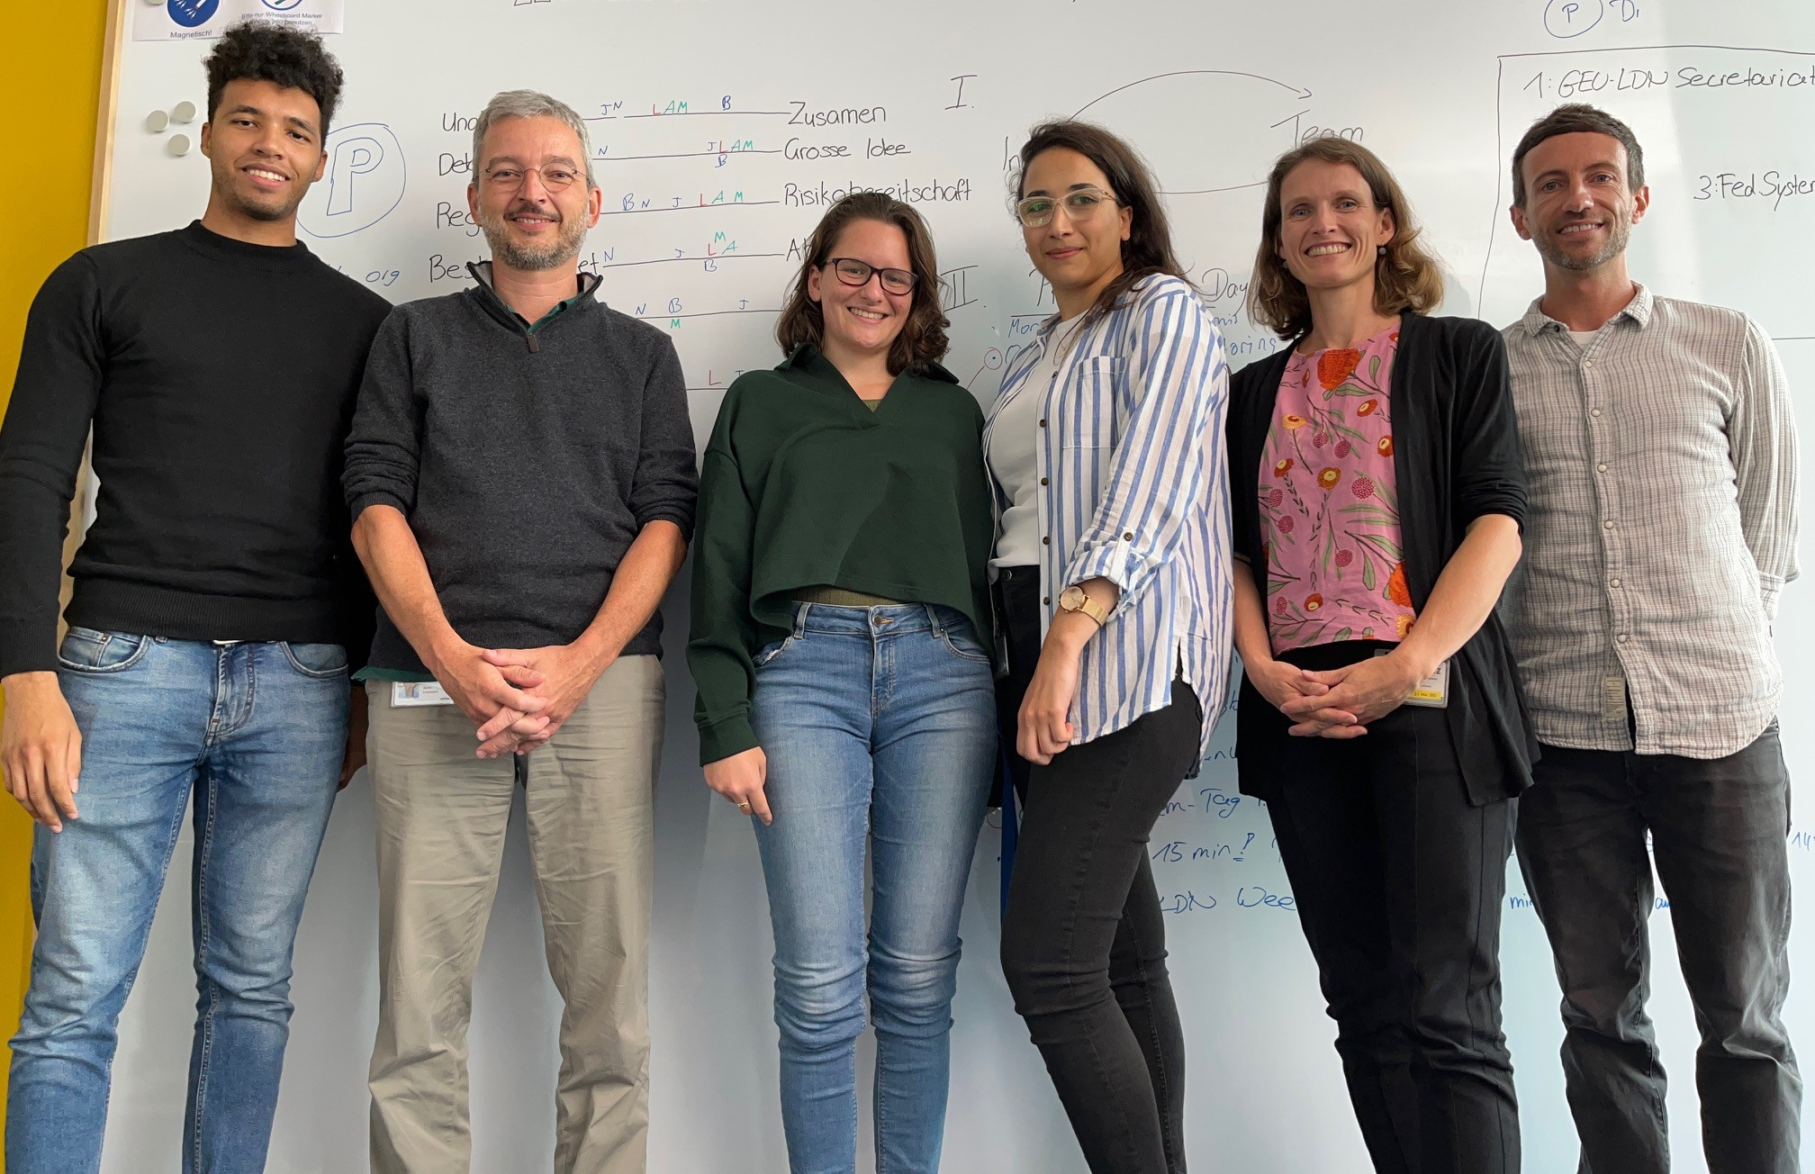
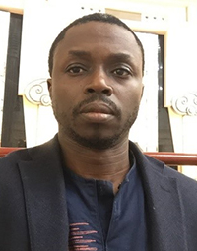
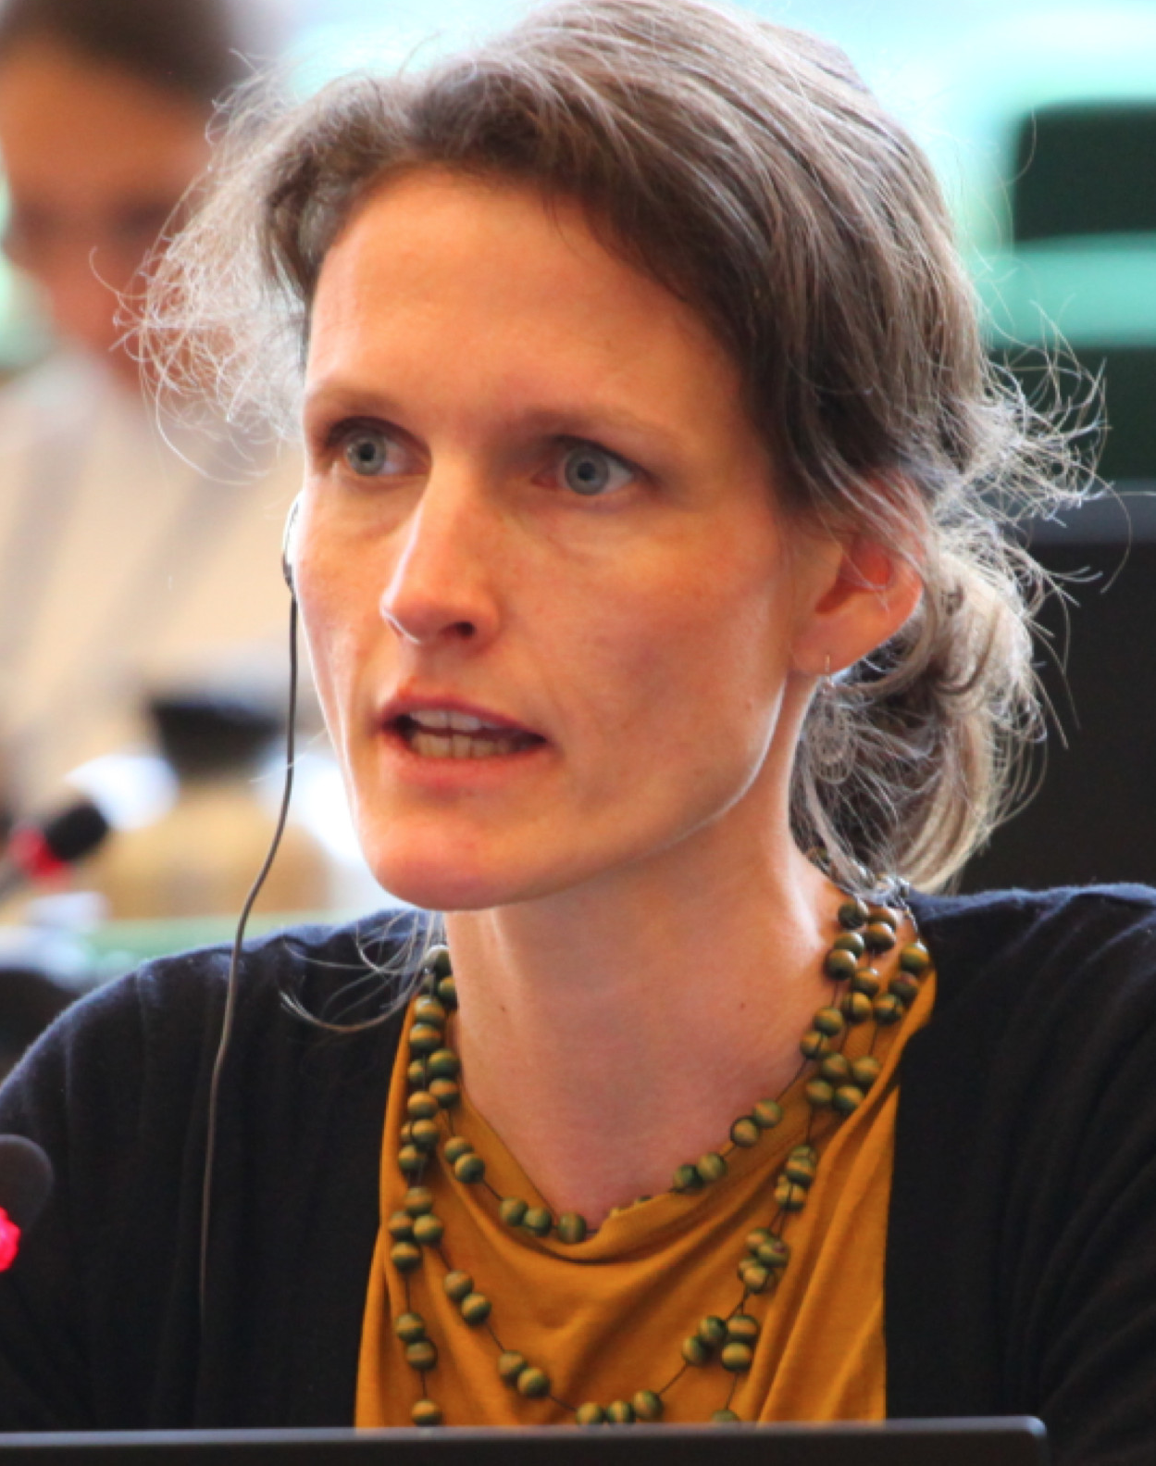
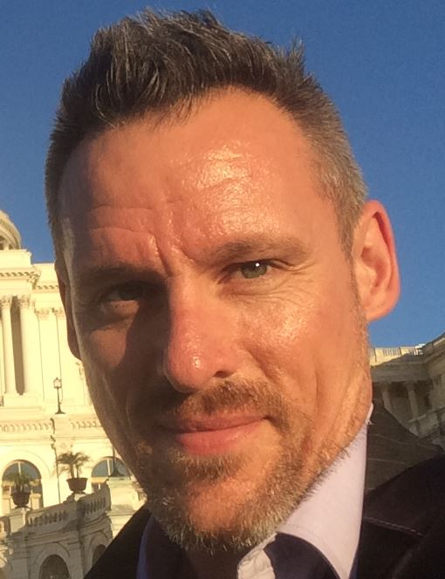
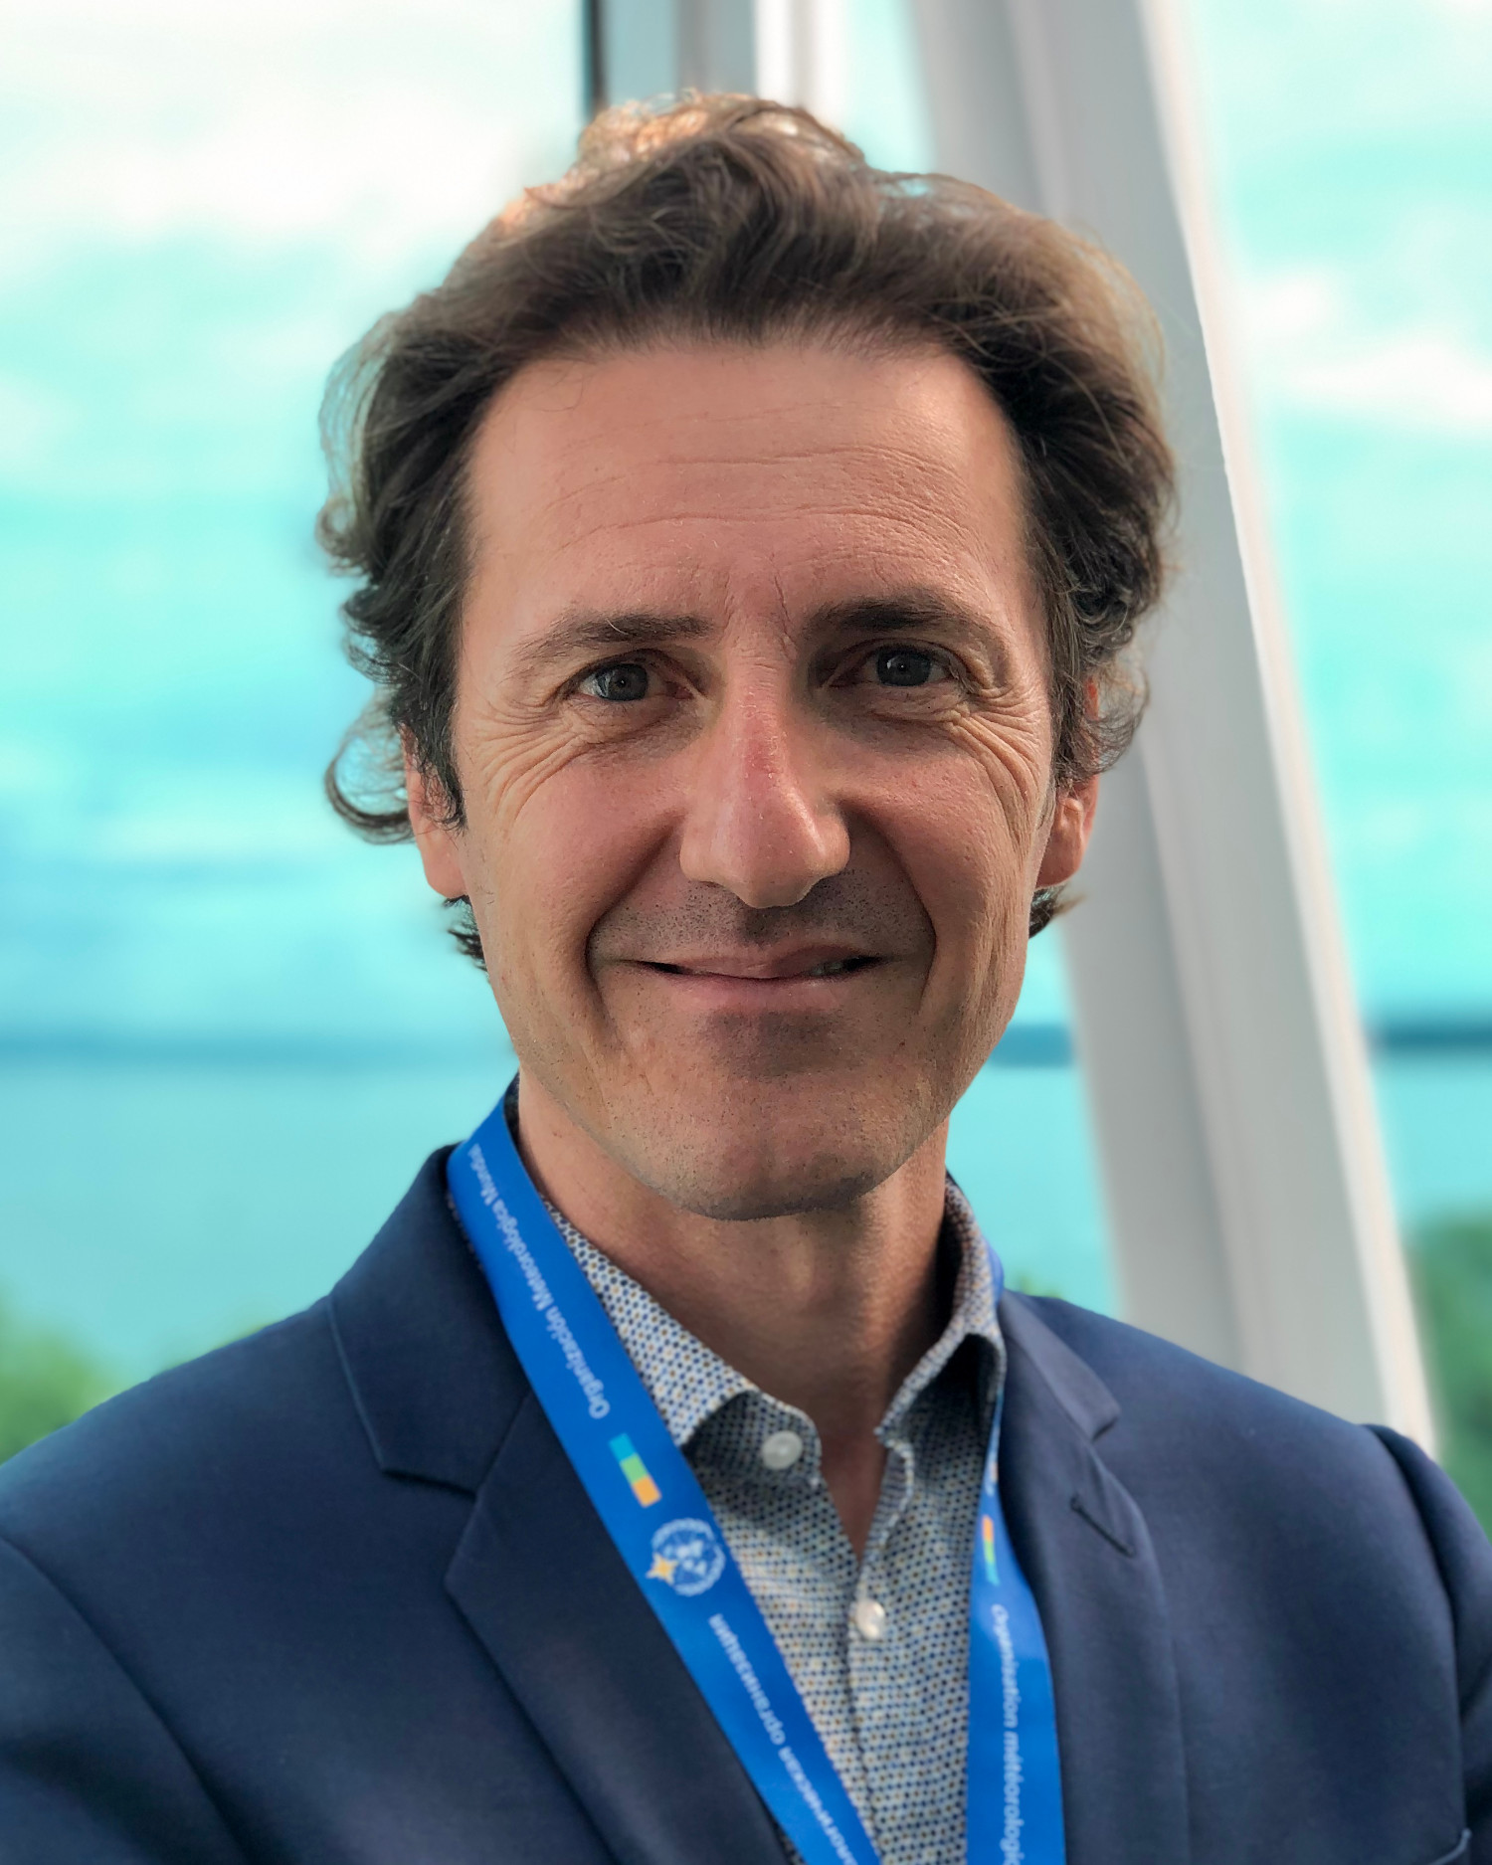
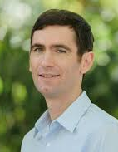
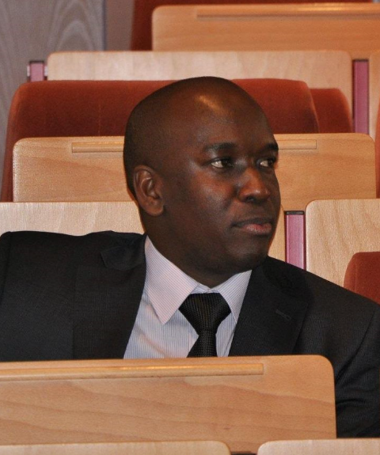
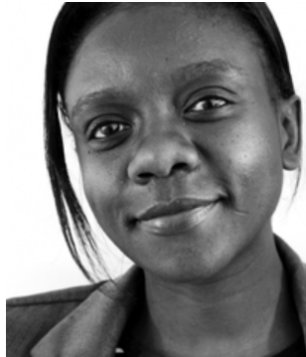
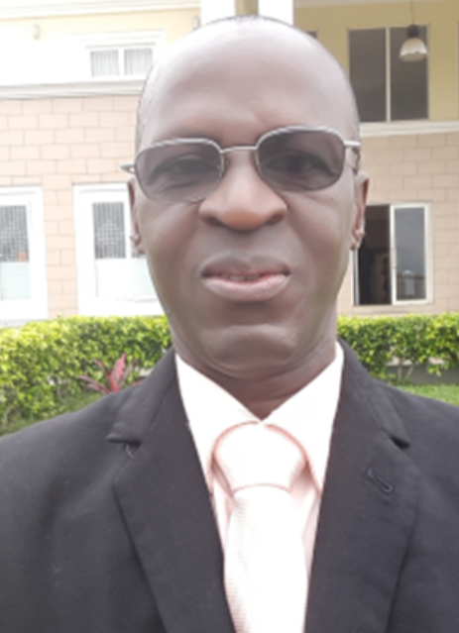
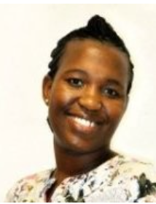
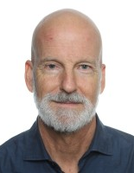
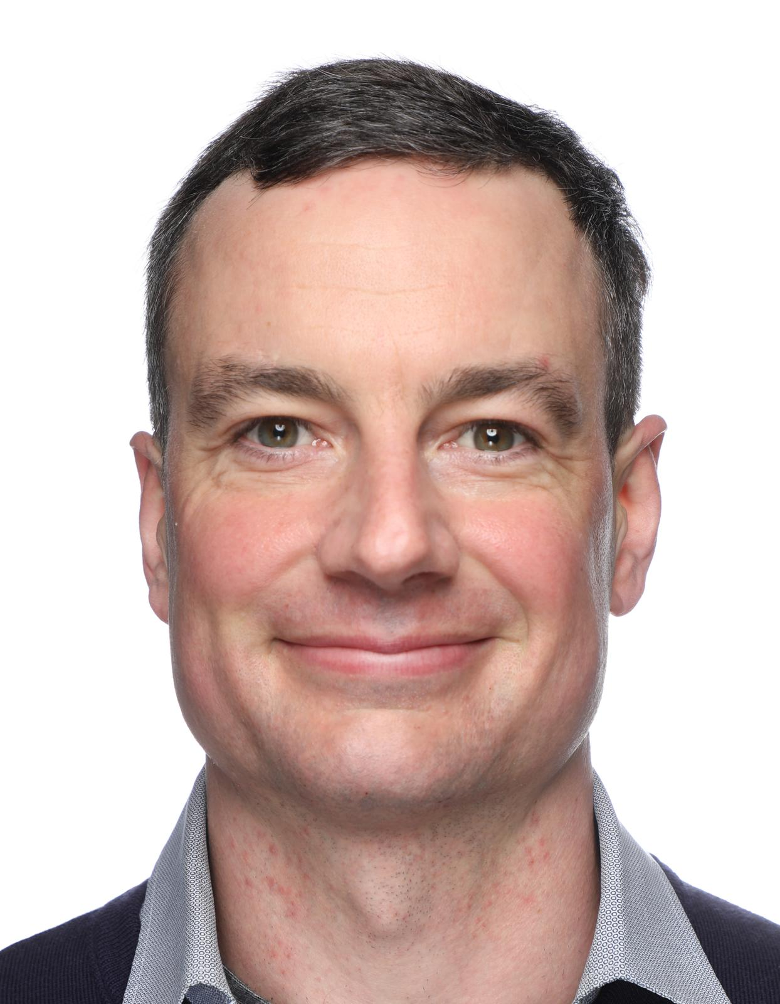
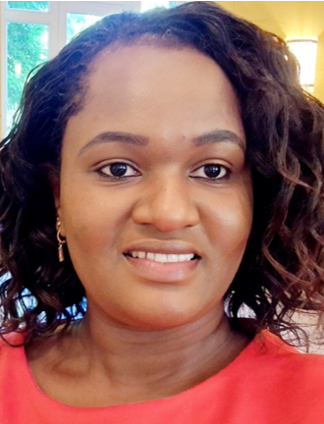
GEO-LDN leads group info@geo-ldn.org
GEO-LDN Secretariat
geo-ldn@giz.de
Co-Chairs
GEO
Secretariat
Amos
Ka-Bobah
Antje
Hecheltjen
Neil
Sims
Laurent Durieux
Working
Group
Co-Leads
From left to right:
Jonas Hansohm
Bernd Eversmann
Lena Moral-Waldmeier
Najwa Aldokr
Antje Hecheltjen
Mark Grasy
Alex
Zvoleff
Timothy
Dube
Mercy
Ojoyi
Patrice
Sanou
Bulelwa
Semoli
UNCCD
AfriGEO
Funded by:
Implemented by:
Sara
Minelli
Barron
Orr
Brian
O‘Connor
Phoebe
Odour

